Slide 1
Artificial Intelligence
How do people really feel?
Marie Anselmi

Slide 2
Introduction
What is Artificial Intelligence?
“It is the science and engineering of making intelligent machines, especially intelligent computer programs. It is related to the similar task of using computers to understand human intelligence, but AI does not have to confine itself to methods that are biologically observable,” (McCarthy, 2007).
”Intelligence is the computational part of the ability to achieve goals in the world,” (McCarthy, 2007).
Can mimic human intelligent responses, doesn’t need to replicate cognitive processes.
AI includes machine learning, personal assistants, reactive machines, commonsense reasoning systems, etc.

Slide 3
Inspiration: Sophia

Slide 4
Question:
Rational solution:
How do people feel about AI?
Collect data and analyze it.

Slide 5
Data
15 features
Normal features such as age, gender, political views, years of education, etc.
Multiple questions about artificial intelligence
Self knowledge score, definitions, contact with AI and/or VAs, etc
Lots of red herring questions
Target = ‘Sentiment’
1-7 rating
Opportunity for neutral rating (4), bad decision
Intentionally targeting emotional sentiment, not necessarily rational opinion

Slide 6
At A glance
122 respondents
59.016% male respondents, 39.34% female
38.75 mean age (15-76 range)
15.64 mean years of education (indicating high school + some college)
5 median, 4.72 mean ’Sentiment’ (1-7 range, indicating slightly positive neutral)

Slide 7
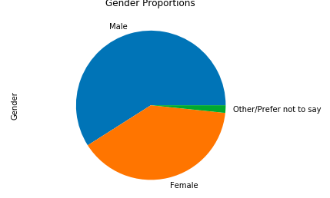
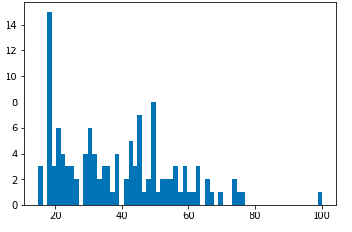
Gender Age

Slide 8
At a Glance
Strongest correlation with ’Sentiment’
Tests - How many/what combination of AI tests have you heard of?
0.2995
AI – self reported knowledge about AI (1-5)
0.2704
AI2 – Do you have contact with AI in daily life? Y/N
0.2109

Slide 9
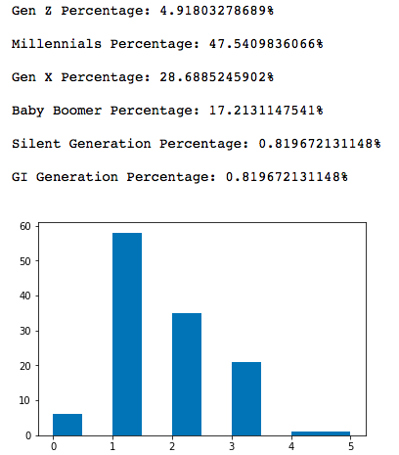
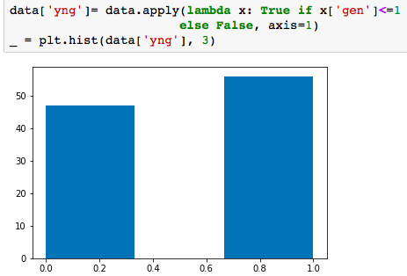
Feature engineering
Age categories by decade
Generations
Mostly Millennials and Gen X
Young
<37

Slide 10
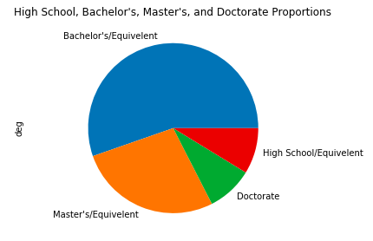
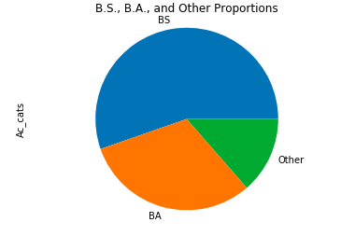
Feature Engineering
Degree Categories
Academic Categories

Slide 11
Feature Engineering
Sentiment categories
’Pos’ – sentiment > neutral = positive
’~Neg’ – sentiment >= 4 = not negative
‘sent_cats’ – three categories, positive(2), neutral(1), and negative(0)
MISTAKE #1:
Giving a neutral option on my scale features

Slide 13
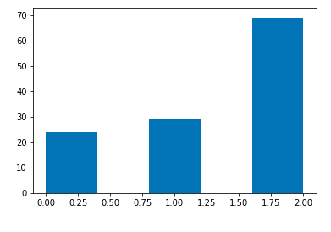
’sent_cats’

Slide 14
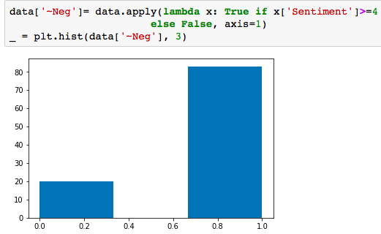
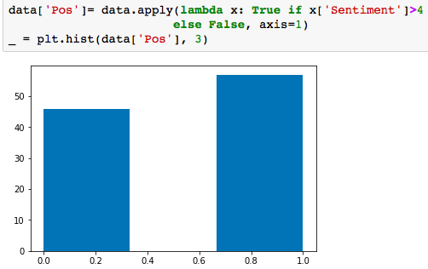
TARGET:

Slide 15
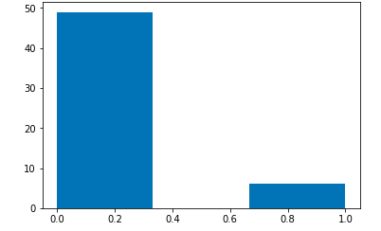
Feature Engineering
Unconventional features
Choosing definition of intelligence
Belief of interaction with AI every day
Etc.
Intentionally created to assess how informed participants actually were

Slide 16
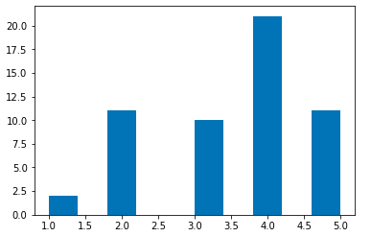
Feature Engineering
Previous heuristic was too harsh
Expected overestimation of self-knowledge, but not that drastic

Slide 17
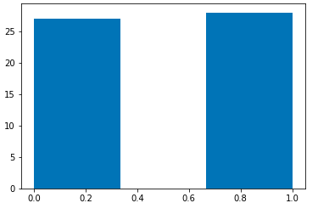
Feature Engineering

Slide 18
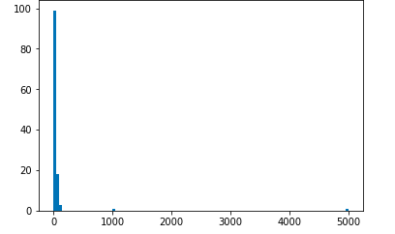
Feature Engineering
‘McCarthy’
‘Films’
Had to normalize a few outliers to see data clearly (1000 and 5000)
Used median because mean was all messed up
I did end up engineering this, but only as an afterthought
On to analysis . . .

Slide 19
Data Analysis - Supervised Methods Initial Expectations
Correlations: ’AI2’/’brain’ had highest positive correlation with ‘Pos’
If you recognize having contact with AI daily, you’re less likely be afraid of it
Initial Hypothesis: Films would negatively correlate to Sentiment
Not supported
Could be a sampling error

Slide 20
Data Analysis - Supervised Methods Model Evaluation
Decision tree
Most consistent max_depth=1(baseline was generally best)
Accuracy = 0.61538
Logistic Regression - penalty =‘l1’ and ‘l2’(default)
Usually best model
L1 Accuracy=0.8462
L2 Accuracy=0.7692
LinearSVC
Accuracy = 0.6152
Learning Curves – Generally models would have benefitted from more data

Slide 21
Data Analysis – Unsupervised Methods
Reverted to original cleaned data
Dendrogram: 2 distinct clusters
KMeans and Agglomerative Clustering
Used ‘Films’ ≤ 33.5, classified 90 of 91
‘Academic’ ≤ 3.5 for remaining individual
I chose not to mess with ‘Films’ in my feature engineering
Mostly because I couldn’t think of a feature name, ’couch_potato’?
Just kidding, of course I messed with it.
Split close to mean (18.5) though, and unsupervised clustering used higher number.

Slide 22
Business implementation Scenario: Sir-Phia
Data was not collected with business usage in mind
Siri-Sophia hybrid
Sir-phia
Pretend I wouldn’t get sued
Personal assistant/robot, like in Her but with a physical component as well as the omnipresent virtual one

Slide 23
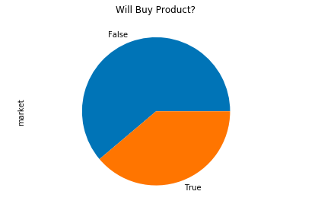
Business implementation Scenario: Sir-Phia
New feature ‘market’
‘AI3’ == robots or VAs | VA == Yes
And ‘Pos’ == True
Deleted features my company probably wouldn’t know
'AI3', 'Pos','AI', 'AI4', 'Tests', 'cluster'

Slide 24
Business Implementation
Costs
Manufacturing – $300 per unit
Marketing - $0.50 per customer
Price of Sir-Phia - $1,000
Cost-Benefit Matrix
 | Buy | Won’t Buy
Contact | $999.5 (TP) | -$0.50 (FP)
Don’t Contact | $0 (FN) | $0 (TN)

Slide 25
Business Implementation scenario: EV Model Evaluation
Decision trees max_depth=1
Worst accuracy (≈75%)
Lowest EV (≈450)
Logistic Regressions
Generally best accuracy (≈93%)
Decent and most consistent EV (≈640)
LinearSVC
Mediocre accuracy (≈92%)
Best EV, but very inconsistent (≈720)
Only model that frequently didn’t make costly (fp) errors

Slide 26
Conclusion
Pretty crappy dataset
Too small and biased to be terribly useful
My clever AI assessment didn’t pan out, but it did give me unique and interesting features to work with
Good thing quasi-independent variables didn’t factor into sentiment

Slide 27
Limitations Regrets
Surveys are not my forte
Neutral response option = very bad idea
Probably very biased volunteer sample
Programmers – shifted demographic, but probably not representative
Facebook contacts
Other potential features – nationality, AI media (rather than just films), etc.
Size matters in data science

Slide 28
Concluding Remarks
Data can be easily manipulated via feature engineering
Only changed 2 values in my entire dataset, still had a lot of flexibility
Good thing to be aware of with this subject’s growing popularity
While overcomplicated AI assessment didn’t pan out, there was evidence that knowledge about AI positively correlates with sentiment
AI is more than Siri, Alexa, Her, and Blade Runner 2045
Science as well as technology
Already implemented in our lives

Slide 29
“The oldest and strongest emotion of mankind is fear, and the oldest and strongest kind of fear is fear of the unknown.”
~ H. P. Lovecraft

